Slide 1

Multidimensional Arrays
TUIT
C++ Programming, Fall 2016
Lab #8
(I - part)

Slide 2
Read the lecture notes doing following tasks:
TUIT
Practice (I - part)
*Sum elements column by columns;
*Sum the major diagonal in a matrix;
Algebra: add two matrices;
**Algebra: multiply two matrices;
**Algebra: 2 x 2 matrix inverse;
*** TicTacToe game;
**Pattern recognition: consecutive four equal numbers;
***Game: connect four;
*Central city;
*Transpose of a matrix;
*Markov matrix;
*Row sorting;

Slide 3


TUIT
1. *Sum elements column by columns
Write a function that returns the sum of all the elements in a specified column in a matrix using the following header:
const int SIZE = 4;
double sumColumn(const double m[][SIZE], int rowSize,
int columnIndex);
Write a test program that reads a 3-by-4 matrix and displays the sum of each column. Here is a sample run:
Enter 3-by-4 matrix row by row: 1.5 2 3 4 5.5 6 7 8 9.5 1 3 1 Sum of the elements at column 0 is 16.5 Sum of the elements at column 1 is 9 Sum of the elements at column 2 is 13 Sum of the elements at column 3 is 13

Slide 4
TUIT
2. *Sum the major diagonal in a matrix
Write a function that sums all the double values in the major diagonal in an nxn matrix of double values using the following header:
const int SIZE = 4;
double sumMajorDiagonal(const double m[][SIZE]);
Write a test program that reads a 4-by-4 matrix and displays the sum of all its elements on the major diagonal. Here is a sample run:
Enter a 4-by-4 matrix row by row: 1 2 3 4 5 6 7 8 9 10 11 12 13 14 15 16 Sum of the elements in the major diagonal is 34

Slide 5
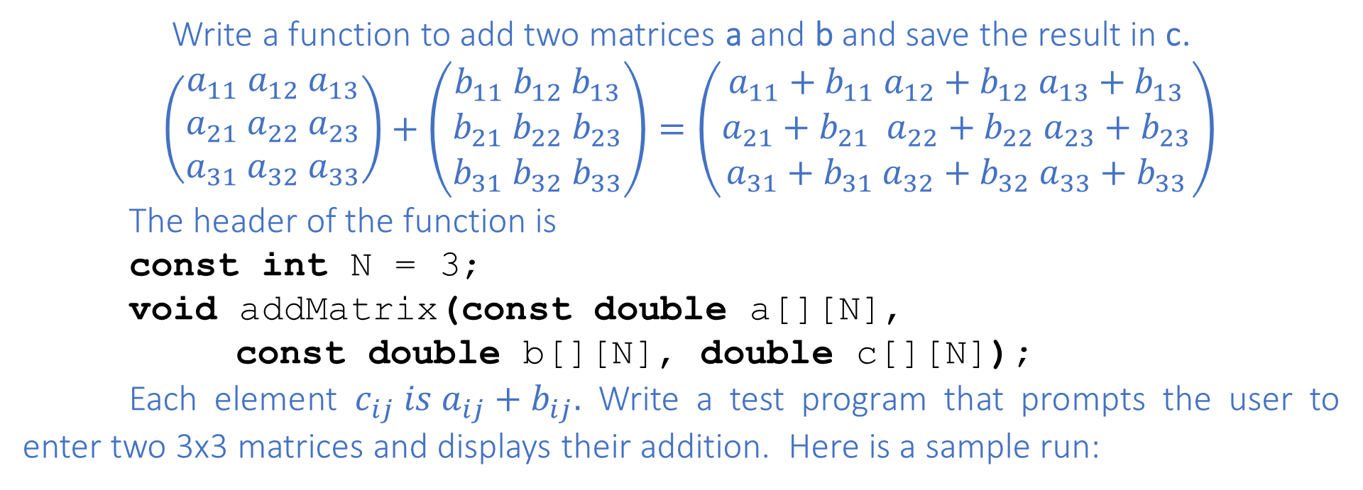
TUIT
3. Algebra: add two matrices
Write a function to add two matrices a and b and save the result in c.
$\left(\begin{aligned}a_{11} a_{12} a_{13} \\ a_{21} a_{22} a_{23} \\ a_{31} a_{32} a_{33}\end{aligned}\right)+\left(\begin{aligned}b_{11} b_{12} b_{13} \\ b_{21} b_{22} b_{23} \\ b_{31} b_{32} b_{33}\end{aligned}\right)=\left(\begin{aligned}a_{11}+b_{11} a_{12}+b_{12} a_{13}+b_{13} \\ a_{21}+b_{21} a_{22}+b_{22} a_{23}+b_{23} \\ a_{31}+b_{31} a_{32}+b_{32} a_{33}+b_{33}\end{aligned}\right)$
The header of the function is
const int N = 3;
void addMatrix(const double a[][N],
const double b[][N], double c[][N]);
Each element $c_{ij} is a_{ij}+b_{ij}.$ Write a test program that prompts the user to enter two 3x3 matrices and displays their addition. Here is a sample run:
Enter matrix1: 1 2 3 4 5 6 7 8 9 Enter matrix2: 0 2 4 1 4.5 2.2 1.1 4.3 5.2 The addition of the matrices is 1 2 3 0 2 4 1 4 7 4 5 6 + 1 4.5 2.2 = 5 9.5 8.2 7 8 9 1.1 4.3 5.2 8.1 12.3 14.2

Slide 6
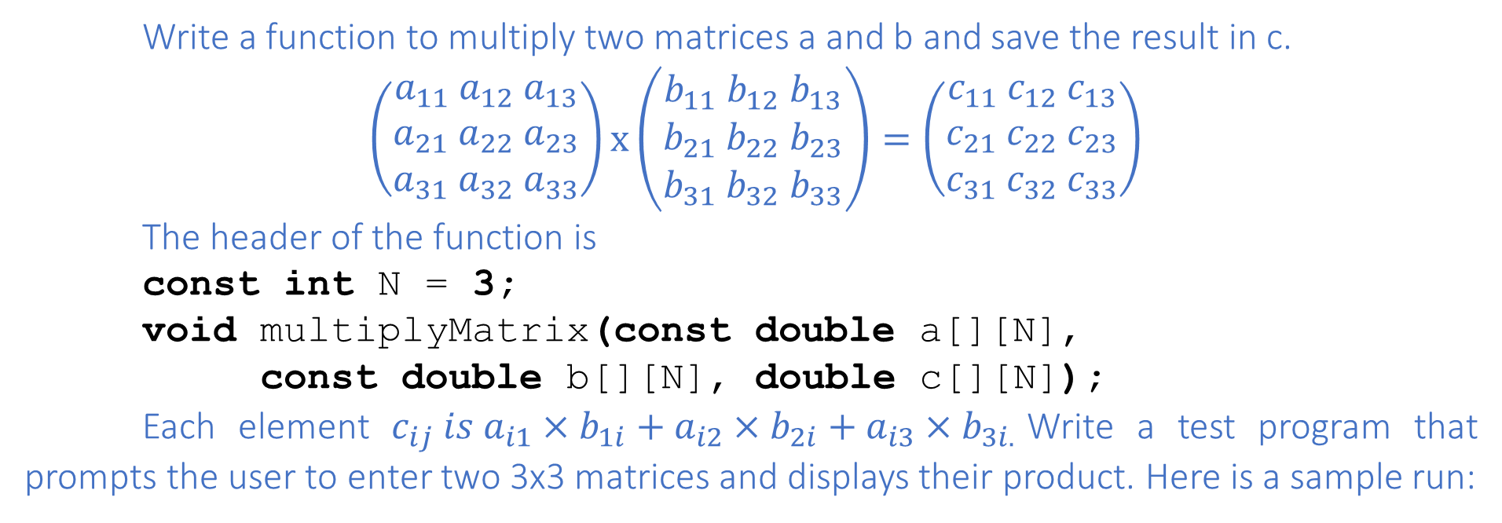
TUIT
4. **Algebra: multiply two matrices
Write a function to multiply two matrices a and b and save the result in c.
$$\left(\begin{aligned}a_{11} a_{12} a_{13} \\ a_{21} a_{22} a_{23} \\ a_{31} a_{32} a_{33}\end{aligned}\right)x\left(\begin{aligned}b_{11} b_{12} b_{13} \\ b_{21} b_{22} b_{23} \\ b_{31} b_{32} b_{33}\end{aligned}\right)=\left(\begin{aligned}c_{11} c_{12} c_{13} \\ c_{21} c_{22} c_{23} \\ c_{31} c_{32} c_{33}\end{aligned}\right)$$
The header of the function is
const int N = 3;
void multiplyMatrix(const double a[][N],
const double b[][N], double c[][N]);
Each element $c_{ij} is a_{i1}×b_{1i}+a_{i2}×b_{2i}+a_{i3}×b_{3i.}$Write a test program that prompts the user to enter two 3x3 matrices and displays their product. Here is a sample run:
Enter matrix1: 1 2 3 4 5 6 7 8 9 Enter matrix2: 0 2 4 1 4.5 2.2 1.1 4.3 5.2 The addition of the matrices is 1 2 3 0 2 4 5.3 23.9 24 4 5 6 * 1 4.5 2.2 = 11.6 56.3 58.2 7 8 9 1.1 4.3 5.2 17.9 88.7 92.4

Slide 7
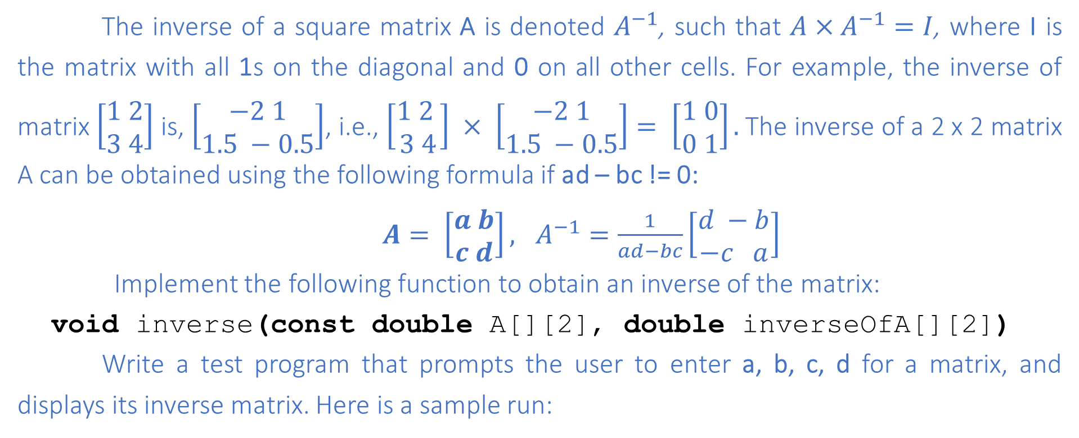
TUIT
5. **Algebra: 2 x 2 matrix inverse
The inverse of a square matrix A is denoted $A^{−1}$, such that $A×A^{−1}=I$, where I is the matrix with all 1s on the diagonal and 0 on all other cells. For example, the inverse of matrix $\left[\begin{aligned}1 2 \\ 3 4\end{aligned}\right]$ is, $\left[\begin{aligned}−2 1 \\ 1.5 −0.5\end{aligned}\right]$, i.e., $\left[\begin{aligned}1 2 \\ 3 4\end{aligned}\right] × \left[\begin{aligned}−2 1 \\ 1.5 −0.5\end{aligned}\right]= \left[\begin{aligned}1 0 \\ 0 1\end{aligned}\right].$The inverse of a 2 x 2 matrix A can be obtained using the following formula if ad – bc != 0:
$A= \left[\begin{aligned}a b \\ c d\end{aligned}\right], A^{−1}=\frac{1}{ad−bc}\left[\begin{aligned}d −b \\ −c a\end{aligned}\right]$
Implement the following function to obtain an inverse of the matrix:
void inverse(const double A[][2], double inverseOfA[][2])
Write a test program that prompts the user to enter a, b, c, d for a matrix, and displays its inverse matrix. Here is a sample run:
Enter a, b, c, d: 0.5 2 1.5 4.5 -6.0 2.6666666666666665 2.0 -0.6666666666666666

Slide 8
TUIT
6. *** TicTacToe game
In a game of TicTacToe, two players take turns marking an available cell in a 3x3 grid with their respective tokens (either X or O). When one player has placed three tokens in a horizontal, vertical, or diagonal row on the grid, the game is over and that player has won. A draw (no winner) occurs when all cells on the grid have been filled with tokens and neither player has achieved a win. Create a program for playing TicTacToe. The program prompts the first player to enter an X token, and then prompts the second player to enter an X token, and the prompts the second player to enter an O token. Whenever a token is entered, the program redisplays the board on the console and determines the status of the game (winm draw, or unfinished).

Slide 9
TUIT
6. *** TicTacToe game
Here is a sample run:
------------- | | | | ------------- | | | | ------------- | | | | ------------- Enter a row (0, 1, or 2) for player X: 1 Enter a column (0, 1, or 2) for player X: 1 ------------- | | | | ------------- | | X | | ------------- | | | | -------------
Enter a row (0, 1, or 2) for player O: 1 Enter a column (0, 1, or 2) for player O: 2 ------------- | | | | ------------- | | X | O | ------------- | | | | ------------- Enter a row (0, 1, or 2) for player X: . . . ------------- | X | | | ------------- | O | X | O | ------------- | | | X | ------------- X player won

Slide 10
TUIT
7. **Pattern recognition: consecutive four equal numbers
Write the following function that tests whether a two-dimensional array has four consecutive numbers of same value, either horizontally, vertically, or diagonally.
bool isConsecutiveFour(int values[][7])
Write a test program that prompts the user to enter the number of rows and columns of a two-dimensional array and then the values in the array and displays the true if the array contains four consecutive numbers with the same value. Otherwise, display false. Here are some examples of the true cases:
0 1 0 3 1 6 1
0 1 6 8 6 0 1
5 6 2 1 8 2 9
6 5 6 1 1 9 1
1 3 6 1 4 0 7
3 3 3 3 4 0 7
0 1 0 3 1 6 1
0 1 6 8 6 0 1
5 5 2 1 8 2 9
6 5 6 1 1 9 1
1 5 6 1 4 0 7
3 5 3 3 4 0 7
0 1 0 3 1 6 1
0 1 6 8 6 0 1
5 6 2 1 6 2 9
6 5 6 6 1 9 1
1 3 6 1 4 0 7
3 6 3 3 4 0 7
0 1 0 3 1 6 1
0 1 6 8 6 0 1
9 6 2 1 8 2 9
6 9 6 1 1 9 1
1 3 9 1 4 0 7
3 3 3 9 4 0 7

Slide 11
TUIT
8. ***Game: connect four
Connect four is a two-player board game in which the players alternately drop colored disks into a seven – column, six-row vertically-suspended grid. The objective of the game is to connect four same colored disks in a row, a column, or a diagonal before your opponent can do likewise. The program prompts two players to drop a RED or YELLOW disk alternately. Whenever a disk is dropped, the program redisplays the board on the console and determines the status of the game (win, draw, or continue).

Slide 12
TUIT
8. ***Game: connect four
Here is a sample run:
| | | | | | | | | | | | | | | | | | | | | | | | | | | | | | | | | | | | | | | | | | | | | | | | ------------------- Drop a red disk at column (0-6): 0 | | | | | | | | | | | | | | | | | | | | | | | | | | | | | | | | | | | | | | | | |R| | | | | | | ------------------- Drop a red disk at column (0-6): 3 | | | | | | | | | | | | | | | | | | | | | | | | | | | | | | | | | | | | | | | | |R| | |Y| | | | -------------------
… … … Drop a red disk at column (0-6): 6 | | | | | | | | | | | | | | | | | | | |R| | | | | | | |Y|R|Y| | | | |R|Y|Y|Y|Y| |R|Y|R|Y|R|R|R| ------------------- The yellow player won

Slide 13
TUIT
9. *Central city
Given a set of cities, the central point is the city that has the shortest total distance to all other cities. Write a program that prompts the user to enter the number of cities and the locations of the cities (coordinates), and finds the central city and its total distance to all other cities. Assume that the maximum number of cities is 20.
Enter the number of cities: 5 Enter the coordinates of the cities: 2.5 5 5.1 3 1 9 5.4 54 5.5 2.1 The central city is at (2.5, 5.0) The total distance to all other cities is 60.81

Slide 14
TUIT
10. *Transpose of a matrix
Write a program that inputs a matrix and displays the transpose of that matrix. A transpose of a matrix is obtained by converting all the rows of a given matrix into columns and vice versa.
Here is a sample run:
Enter a count the matrix’s rows: 3 Enter a count the matrix’s columns: 4 Enter a matrix row-by-row: 1 2 3 4 5 6 7 8 9 0 1 2 The transpose of a matrix: 1 5 9 2 6 0 3 7 1 4 8 2

Slide 15
TUIT
11. *Markov matrix
An nxn matrix is called a positive Markov matrix, if each element is positive and the sum of the elements in each column is 1. Write the following function to check whether a matrix is a Markov matrix:
const int SIZE = 3;
bool isMarkovMatrix(const double m[][SIZE]);
Write a test program that prompts the user to enter a 3x3 matrix of double values and tests whether it is a Markov matrix. Here are sample runs:
Enter a 3 by 3 matrix row by row: 0.15 0.875 0.375 0.55 0.005 0.225 0.30 0.12 0.4 It is a Markov matrix

Slide 16
TUIT
12. *Row sorting
Implement the following function to sort the rows in a two-dimensional array. A new array is returned. The original array is intact.
const int SIZE = 3;
void sortRows(const double m[][SIZE], double result[][SIZE]);
Write a test program that prompts the user to enter a 3x3 matrix of double values and display a new row-sorted matrix. Here is a sample run:
Enter a 3 by 3 matrix row by row: 0.15 0.875 0.375 0.55 0.005 0.225 0.30 0.12 0.4 The row-sorted array is 0.15 0.375 0.875 0.005 0.225 0.55 0.12 0.30 0.4

